Slide 1


Global Superstore Database Design
Team-4
HARIPRIYA JANARDHAN RAO
SAI CHAITANYA NAGANDLA
Hemanth Kumar enuguri
SAHITHI NALLANI
SRI VATSAV BUSI
NIKHIL ANNE

Slide 2

Organization Description
Our dataset is from www.kaggle.com a trusted platform for datasets and all of our information is stored in only ‘One dataset’
Global Superstore is an e-commerce player serving diverse markets globally.
Offers a wide product range, catering to varied customer preferences.
Rapid expansion has led to overwhelming data management challenges.
Transitioning to a powerful database is crucial for sustained competitiveness.
4 Theme Parks

Slide 3
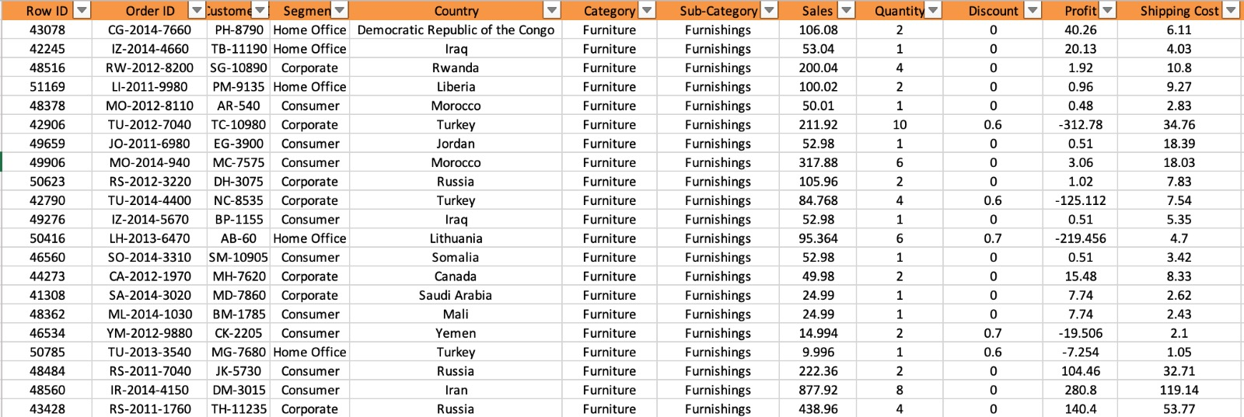
Data Description
4 Theme Parks

Slide 4
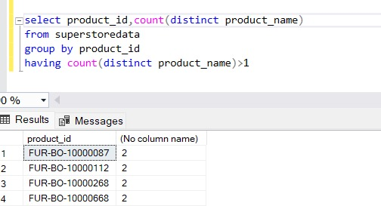
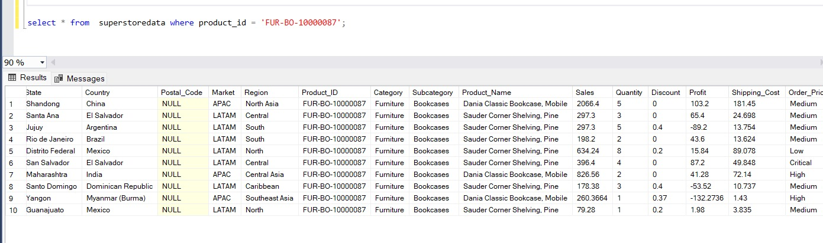
Business Problem-1A
Inherent Data Discrepancies in the Database:
Single product ID associated with multiple product names
Inconsistent product names used in multiple markets
4 Theme Parks

Slide 5
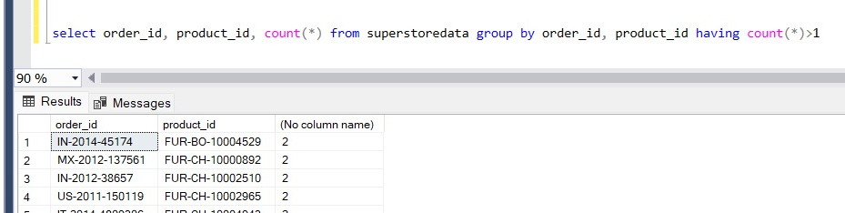
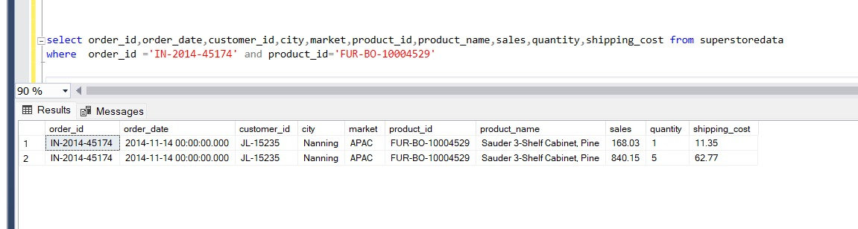
Business Problem-1B
Inherent Data Discrepancies in the Database:
Duplicate entries for same product in one order
4 Theme Parks

Slide 6



Business Problem-2
Inventory Challenges:
Risk of overstocking or understocking due to inaccurate product tracking
Marketing Setbacks:
Potential misdirection of campaigns due to data inconsistencies, wasted resources, decreased ROI on marketing efforts
Customer Service Disruptions:
Shipping delays and wrong product deliveries
4 Theme Parks

Slide 7
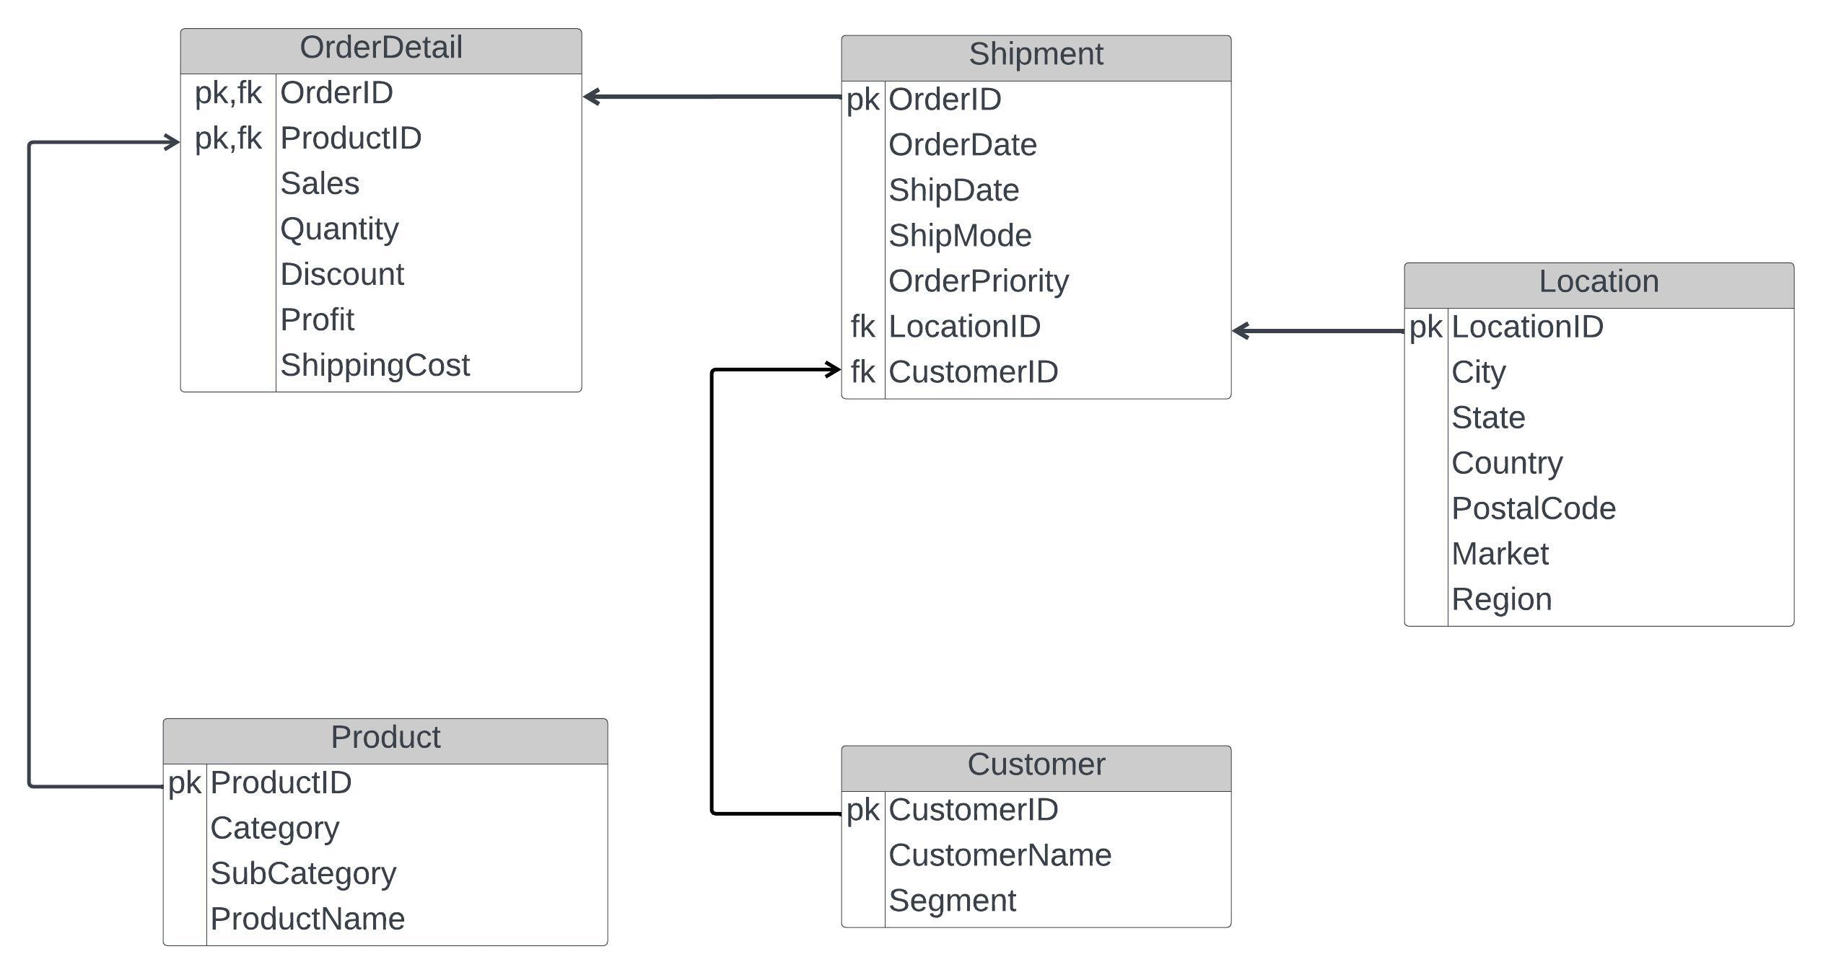
Database Design- Logical
OrderID | ProID
A | X
A | Y
A | Z
OrderID
A
4 Theme Parks

Slide 8
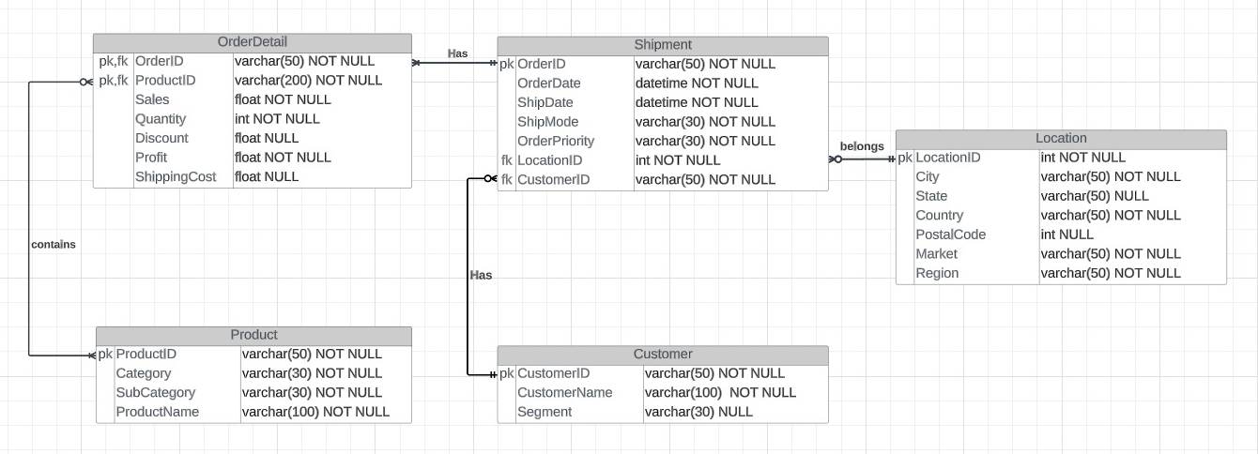
Database Design- Physical
4 Theme Parks

Slide 9
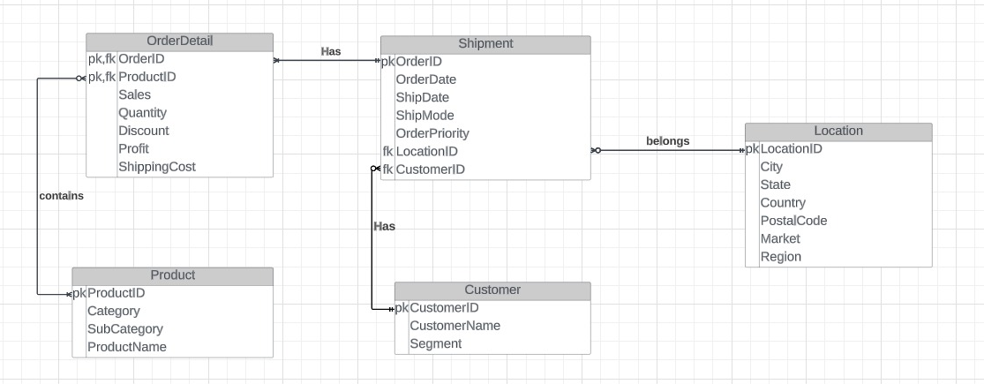
Database Modeling - ER Diagram
Min Cardinality (1-1)
Max Cardinality (N-1)
Min Cardinality (O-1)
Max Cardinality (N-1)
4 Theme Parks
Min Cardinality (O-M)
Max Cardinality (N-M)
Min Cardinality (O-1)
Max Cardinality (N-1)

Slide 10
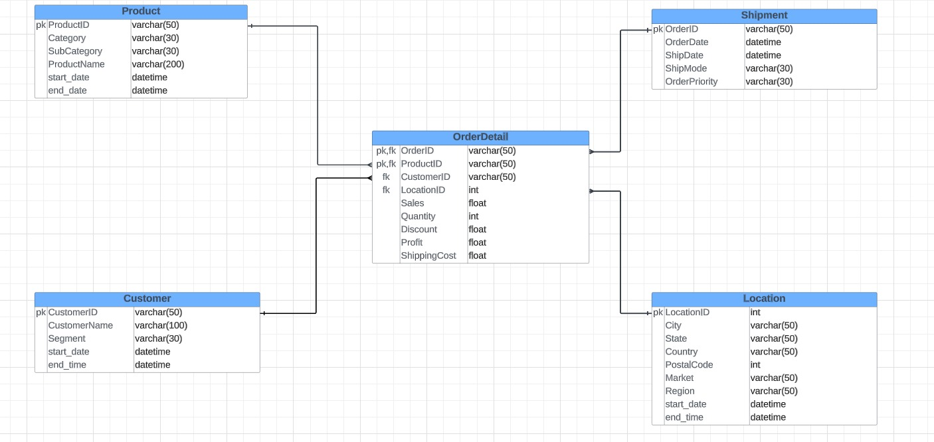
Star Schema
4 Theme Parks

Slide 11

Normalization - Adherence to BCNF
All tables have single-valued, non-duplicated attributes(1NF)
Attributes fully rely on the primary key, avoiding indirect dependencies(2NF & 3NF)
OrderDetails Table has a composite primary key - OrderID and ProductID. All the other attributes (like Sales, Quantity, Discount, etc.) depend on the entire composite key
Though the Shipment table has foreign keys - LocationID and CustomerID, they aren't determinants for other non-key attributes
4 Theme Parks

Slide 12
Normalization - Adherence to BCNF
4 Theme Parks

Slide 13
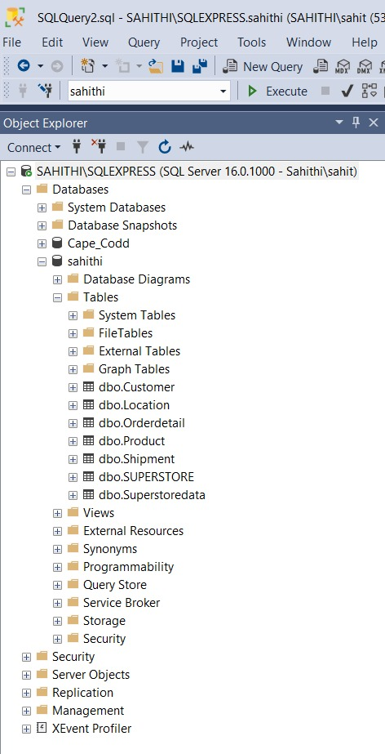
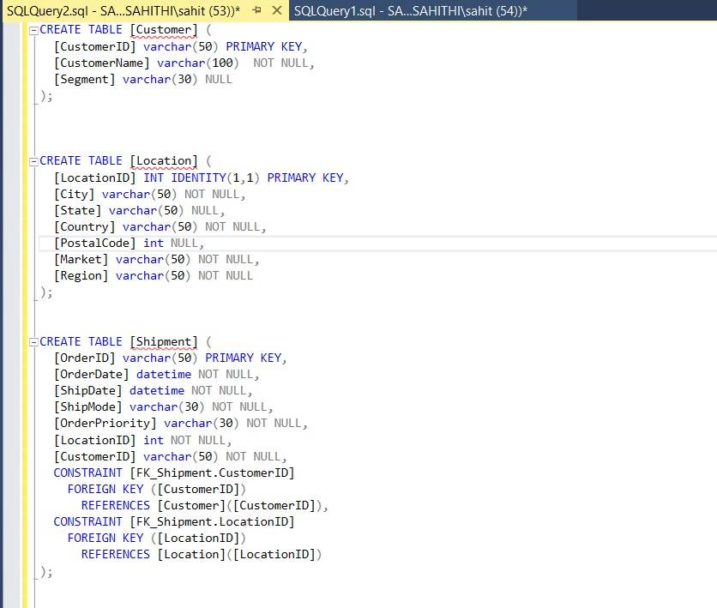
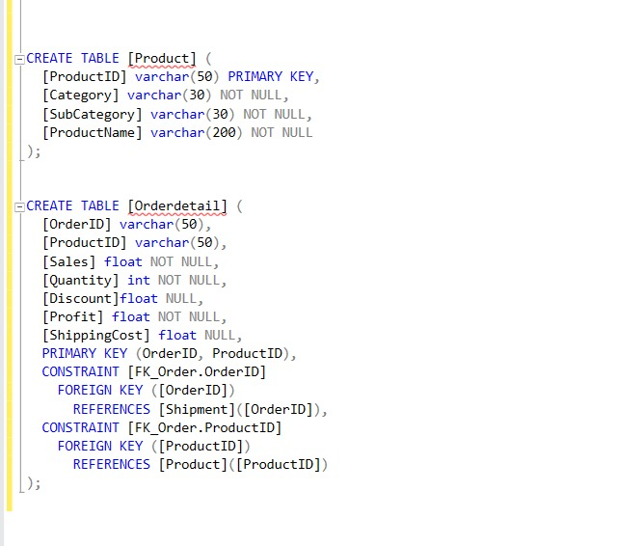
SQL Queries- Create
4 Theme Parks

Slide 14
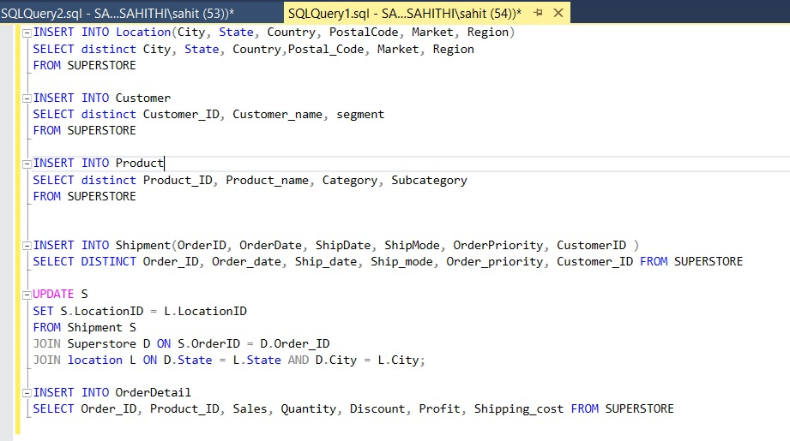
SQL Queries- Insert & Update
4 Theme Parks

Slide 15
Business Problem-1A
Inherent Data Discrepancies in the Database:
Single product ID associated with multiple product names
Inconsistent product names used in multiple markets
4 Theme Parks

Slide 16
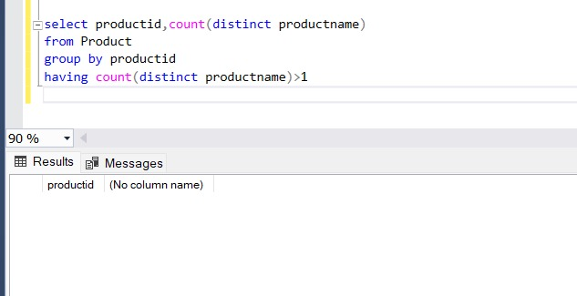
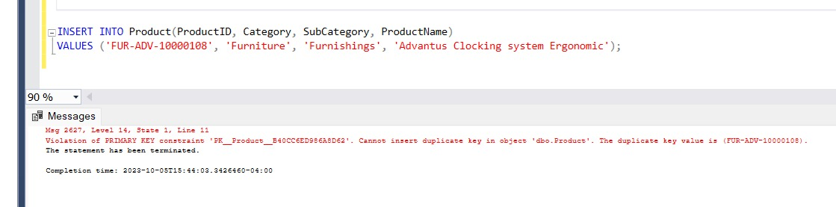
Business Problem Solution-1A
Single product ID is associated with only one product name
Possibility of having multiple product names is avoided
4 Theme Parks

Slide 17
Business Problem-1B
Inherent Data Discrepancies in the Database:
Duplicate entries for same product in one order
4 Theme Parks

Slide 18
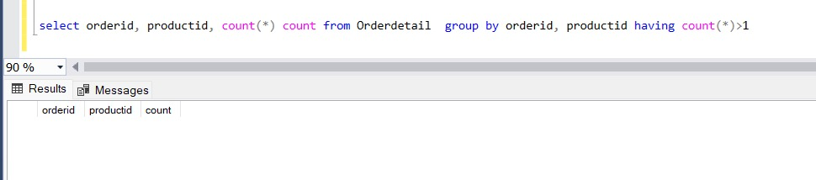
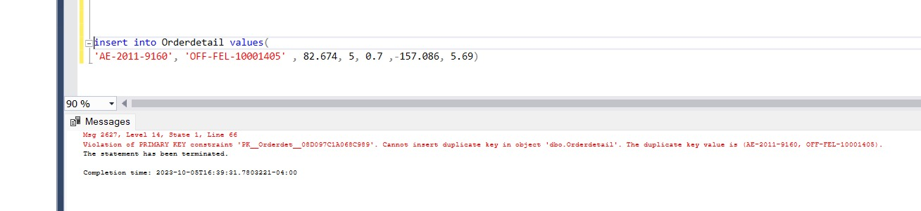
Business Problem Solution-1B
Usage of Composite key along with referential integrity and constraints solves the issue of duplicate entries for a product in order
4 Theme Parks

Slide 19
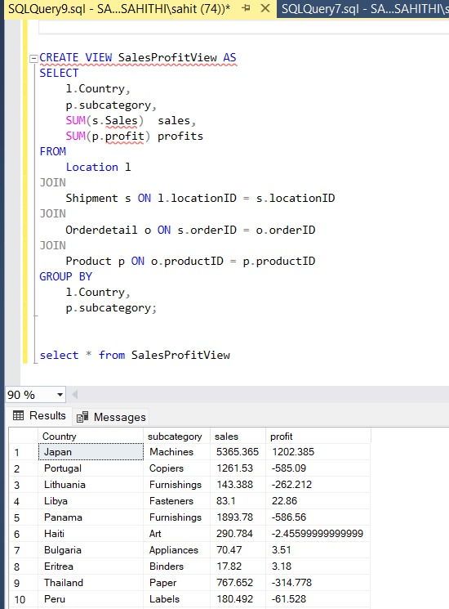
SQL View
4 Theme Parks

Slide 20
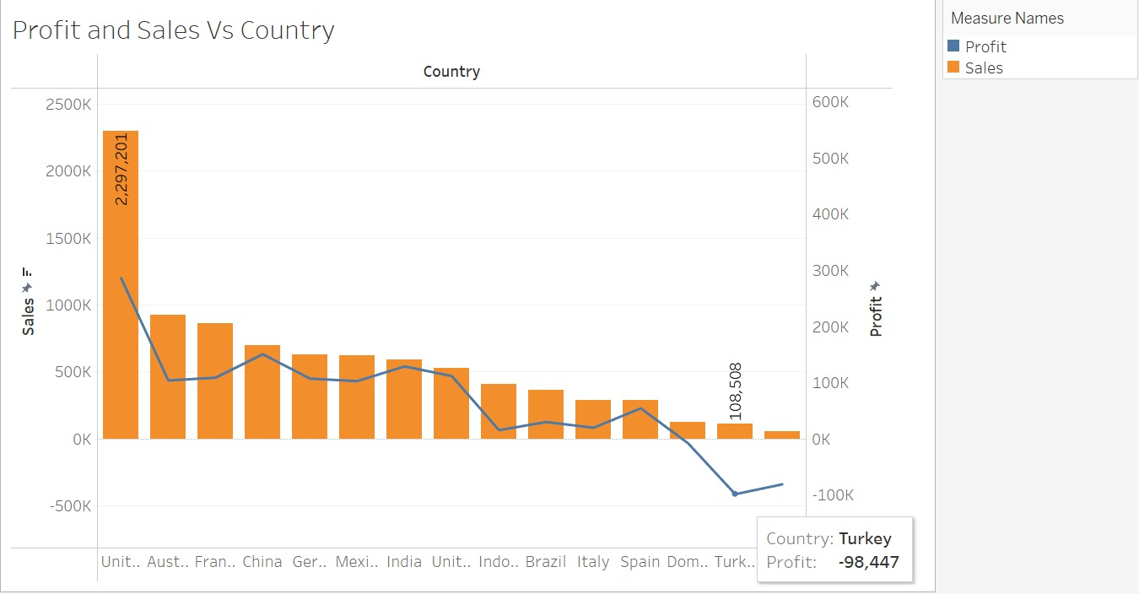
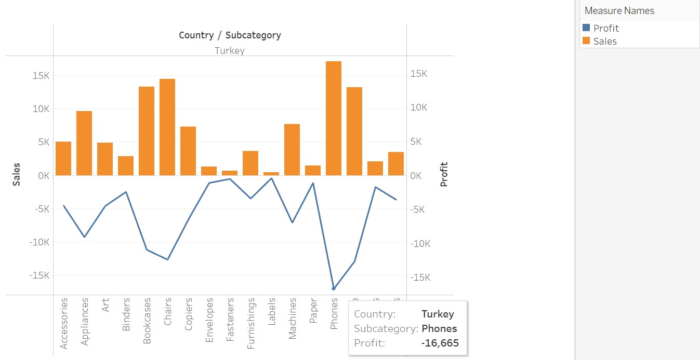
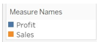
Business Problem Solution-2
Inventory Challenges:
Risk of overstocking or understocking due to inaccurate product tracking
‘Phones’ subcategory in Turkey is facing huge losses
Risk of overstocking can be avoided based on this analysis
4 Theme Parks

Slide 21
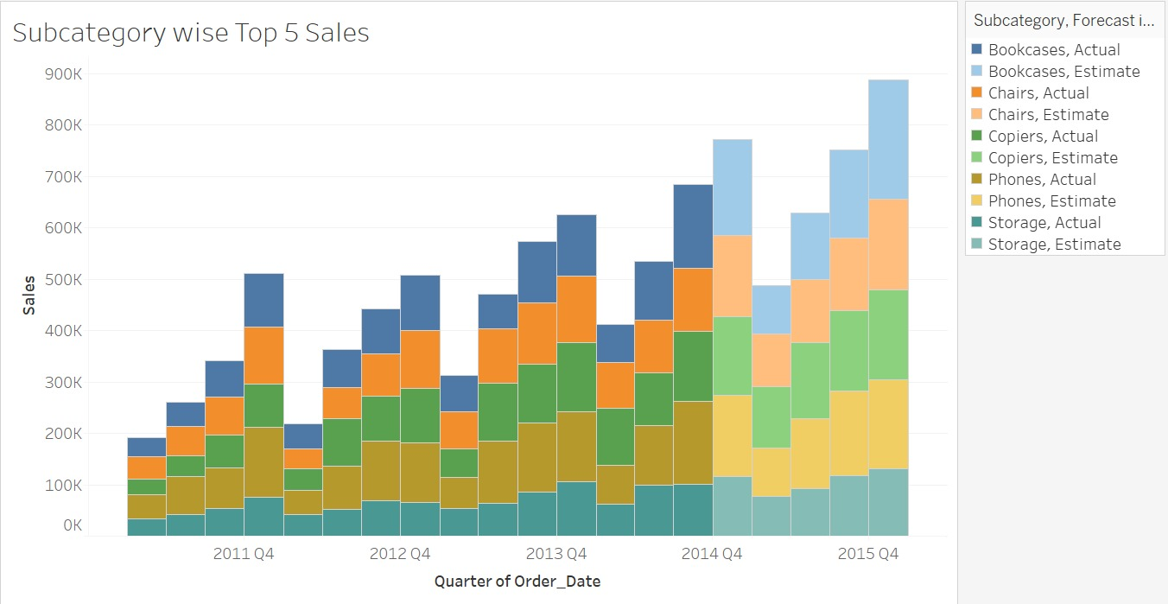
Business Problem Solution-2
Inventory Challenges:
Risk of overstocking or understocking due to inaccurate product tracking
Future sales can be predicted based on the existing database
Sales from Q1 to Q4 increase every year with Q4 having significantly more sales
Risk of Understocking can be avoided during peak sales duration
4 Theme Parks

Slide 22

Project Learnings
Recognized issues like multiple products tied to a single ID, varying product representations across markets, and repetitive city entries highlighted the need for improved data management and standardization
Successfully designed a database that adheres to the principles of 1NF, 2NF, 3NF, and BCNF
The project provided the team with valuable insights in constructing ER diagrams and delineating logical and physical aspects of database design, leading to a comprehensive grasp of database architecture and design principles
Addressed inventory challenges using Tableau data analysis, which are the critical need for precise and consistent data management in order to optimize resources and enhance customer satisfaction
4 Theme Parks

Slide 23
THANK YOU
34 Resorts & Hotels
4 Theme Parks
2 Water Parks
1 Shopping Mall
4 Golf Courses
1 Wedding Pavilion
1 ESPN Sports Complex
2 Miniature Golf Courses

